Slide 1
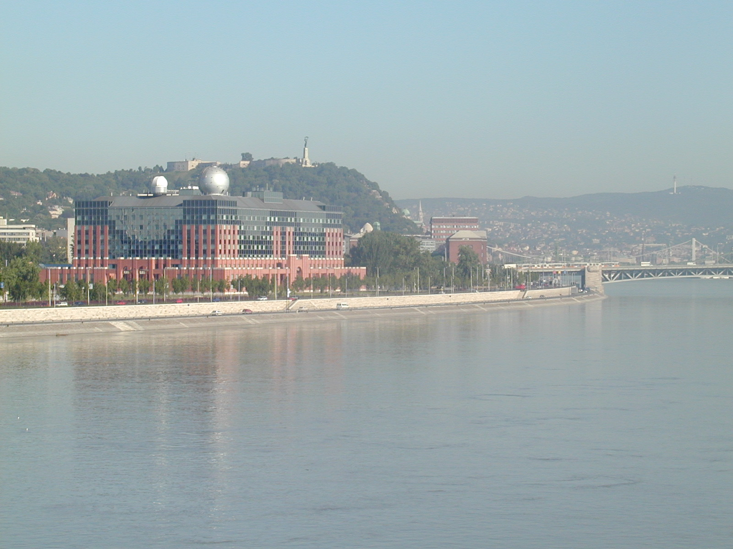


Strengthening mechanisms and low-temperature superplasticity of an ultrafine-grained AlZnMg-Zr alloy
Nguyen Q. Chinh, Jenő Gubicza, János L. Lábár, Zsolt Kovács, János Lendvai,
Elena V. Bobruk, Maxim Yu. Murashkin and Ruslan Z. Valiev
Department of Materials Physics, Eötvös Loránd University, Budapest, HUNGARY
Institute for Technical Physics and Materials Science, Centre for Energy Research, HAS, HUNGARY
Ufa State Aviation Technical University, Institute of Physics of Advanced Materials, RUSSIA
BNM-2019, Ufa, Russia
September 25-27., 2019
.
Notes:
Na, mi van itt?

Slide 2
Ultrafine-grained AlZnMg alloys
Outline:
-Conventional (coarse-grain) supersaturated AlZnMg alloys
-Some new results on ultrafine-grained samples

Slide 3
Conventional AlZnMg alloys
Conventional supersaturated AlZnMg alloys :
-Basic materials in several industries
-Strengthening mechanisms: precipitated processes
•Age-hardenable alloys
•Homogenization (at about 450-500ºC)
Water-quenching into RT water Supersaturated solid solution (S.S.S.S) state

Slide 4
Conventional AlZnMg alloys
Conventional supersaturated AlZnMg alloys :
-Strengthening mechanisms: precipitated processes
From supersaturated solid solution (S.S.S.S) state
•S.S.S.S Solution hardening
•Aging at RT-120 ºC Gunier-Preston (GP) zones
•Aging at 80-150 ºC metastable η’ particles
• At higher temperatures stable η precipitates
(with a composition of MgZn₂ )

Slide 5
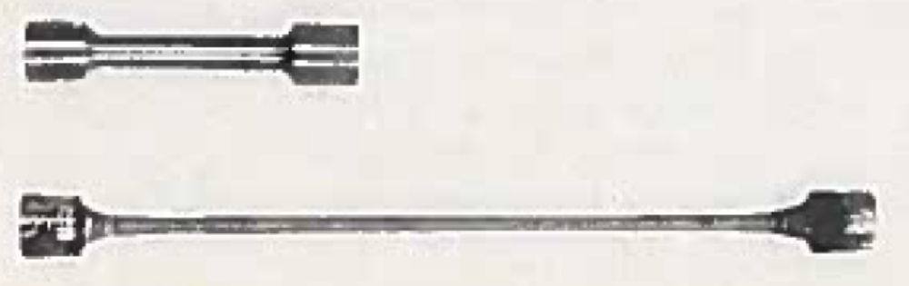
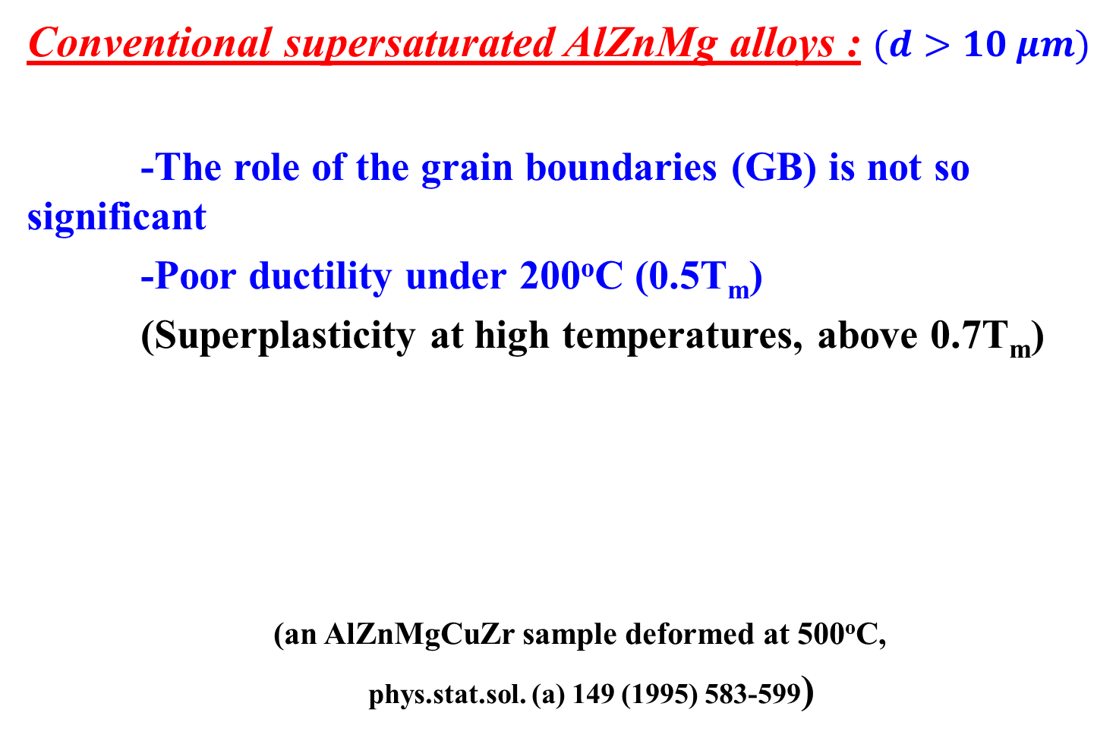
Conventional AlZnMg alloys
Conventional supersaturated AlZnMg alloys : $(d>10 μm)$
-The role of the grain boundaries (GB) is not so significant
-Poor ductility under 200ºC (0.5T_{m})
(Superplasticity at high temperatures, above 0.7T_{m})
(an AlZnMgCuZr sample deformed at 500ºC,
phys.stat.sol. (a) 149 (1995) 583-599)

Slide 6
New results: Ultrafine-grained AlZnMg alloys
Main goals of the present work:
•Improving both the strength and ductility of an AlZnMgZr alloy, and approching the superplasticity under 200ºC (0.5T_{m}) by grain-refinements
•Studying the role of GBs in ultrafine-grained samples

Slide 7
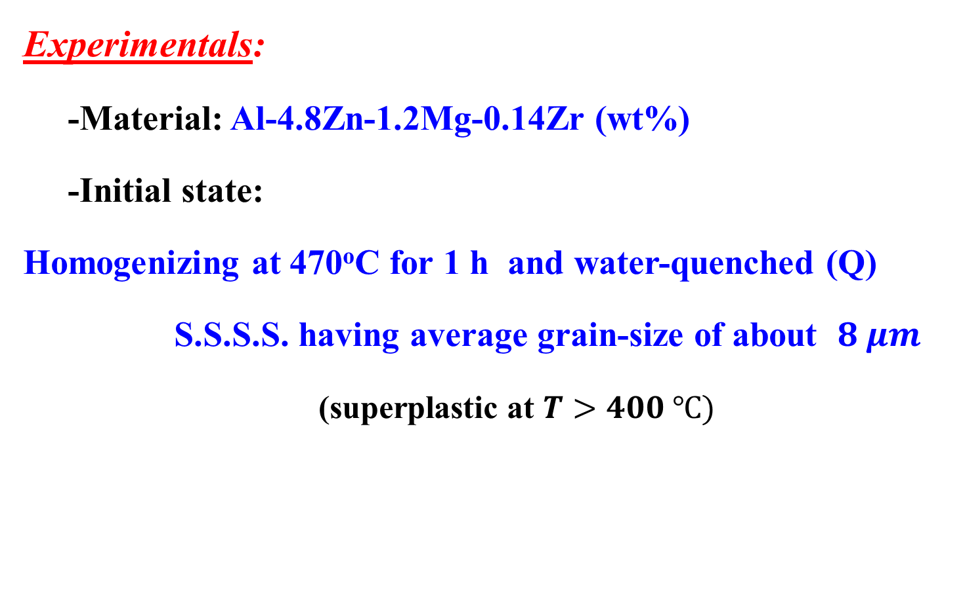
New results: Ultrafine-grained AlZnMg alloys
Experimentals:
-Material: Al-4.8Zn-1.2Mg-0.14Zr (wt%)
-Initial state:
Homogenizing at 470ºC for 1 h and water-quenched (Q)
S.S.S.S. having average grain-size of about $8 μm$
(superplastic at $T>400 ℃)$

Slide 8
New results: Ultrafine-grained AlZnMg alloys
Experimentals:
-Material: Al-4.8Zn-1.2Mg-0.14Zr (wt%)
-Initial state:
Homogenizing at 470ºC for 1 h and water-quenched (Q)
Following the Q within 10-15 min. (MSEA 516 (2009) 248-252)
Severe Plastic Deformation (SPD) processes
•Equal Channel Angular Pressing (ECAP)
•High Pressure Torsion (HPT)

Slide 9
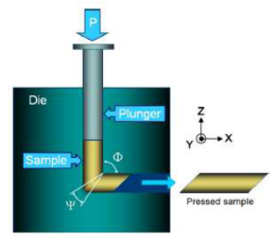
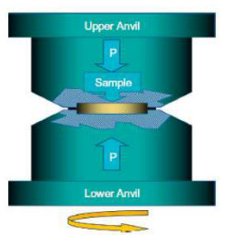
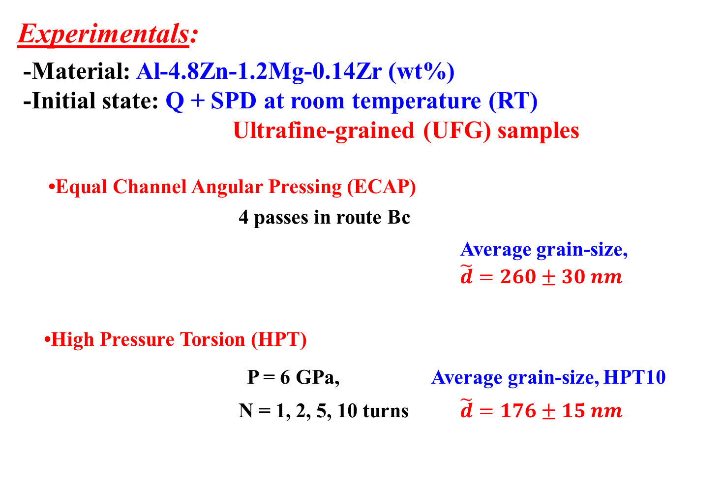
New results: Ultrafine-grained AlZnMg alloys
Experimentals:
-Material: Al-4.8Zn-1.2Mg-0.14Zr (wt%)
-Initial state: Q + SPD at room temperature (RT)
Ultrafine-grained (UFG) samples
•Equal Channel Angular Pressing (ECAP)
4 passes in route Bc
Average grain-size,
$\tilde{d}=260±30 nm$
•High Pressure Torsion (HPT)
P = 6 GPa, Average grain-size, HPT10
N = 1, 2, 5, 10 turns $\tilde{d}=176±15 nm$

Slide 10
New results: Ultrafine-grained AlZnMg alloys
Experimentals:
-Material: Al-4.8Zn-1.2Mg-0.14Zr (wt%)
-Initial state: UFG samples
UFG samples + further agings at 120 -170ºC
-Investigated by:
● Tensile test,
● Transmission electron microscopy (TEM),
● X-ray diffraction
● Depth-sensing indentation (DSI)
● Focused ion beam and scanning electron microscopy (FIB/SEM)
● Differential scanning calorimetric (DSC)

Slide 11
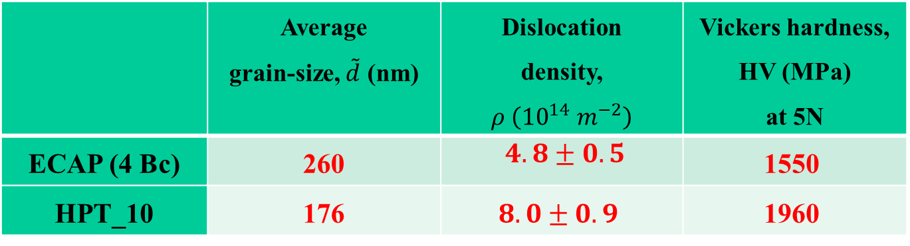
New results: Ultrafine-grained AlZnMg alloys
New results on UFG samples:
-Material: Ultrafine-grained Al-4.8Zn-1.2Mg-0.14Zr
Some intial parameters of the UFG structures
 | Average grain-size, $\tilde{d}$ (nm) | Dislocation density, $ρ \left({10}^{14} m^{−2}\right)$ | Vickers hardness, HV (MPa) at 5N
ECAP (4 Bc) | 260 | $4.8±0.5$ | 1550
HPT_10 | 176 | $8.0±0.9$ | 1960

Slide 12
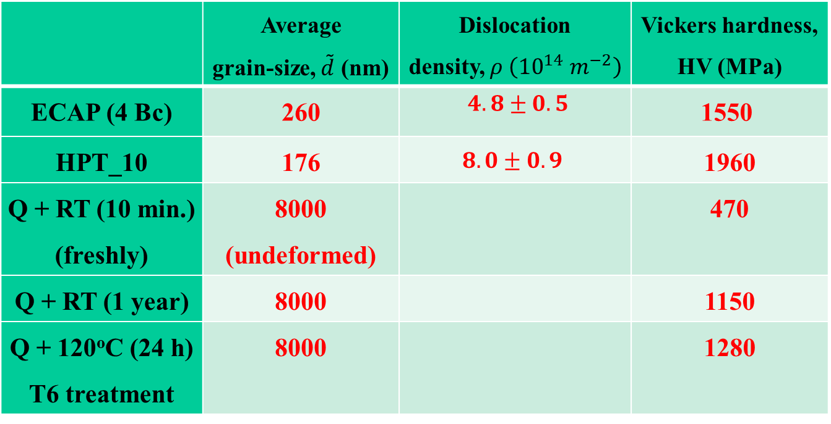
New results: Ultrafine-grained AlZnMg alloys
New results on UFG samples:
-Material: Ultrafine-grained Al-4.8Zn-1.2Mg-0.14Zr
Strengthening effect of SPD
 | Average grain-size, $\tilde{d}$ (nm) | Dislocation density, $ρ \left({10}^{14} m^{−2}\right)$ | Vickers hardness, HV (MPa)
ECAP (4 Bc) | 260 | $4.8±0.5$ | 1550
HPT_10 | 176 | $$8.0±0.9$$ | 1960
Q + RT (10 min.) (freshly) | 8000 (undeformed) |  | 470
Q + RT (1 year) | 8000 |  | 1150
Q + 120ºC (24 h) T6 treatment | 8000 |  | 1280

Slide 13
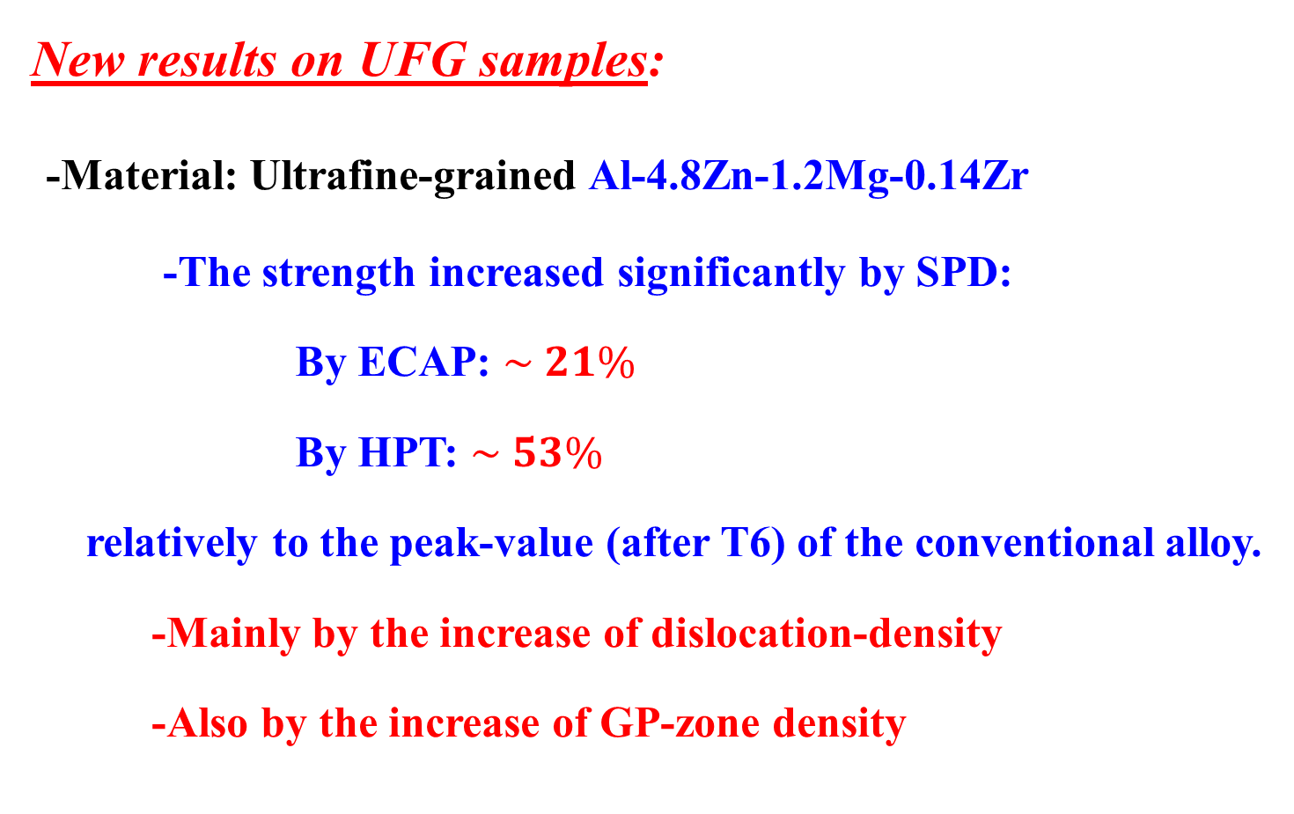
New results: Ultrafine-grained AlZnMg alloys
New results on UFG samples:
-Material: Ultrafine-grained Al-4.8Zn-1.2Mg-0.14Zr
-The strength increased significantly by SPD:
By ECAP: $\sim 21\%$
By HPT: $\sim 53\%$
relatively to the peak-value (after T6) of the conventional alloy.
-Mainly by the increase of dislocation-density
-Also by the increase of GP-zone density

Slide 14
New results: Ultrafine-grained AlZnMg alloys
New results on the ductility of UFG AlZnMgZr samples:
-Background:
● Stable structure of pure UFG Al under 200ºC
(M. Furukawa et al., MSEA 265 (1999) 188., NQC et al. MSEA 410-411 (2005) 234.)
● Poor ductility of UFG materials at RT
Attemps to see how the SPD-processed samples behave
above RT, in the temperature range between 100 - 170ºC?
How the ductility can be improved at acceptable strength?

Slide 15
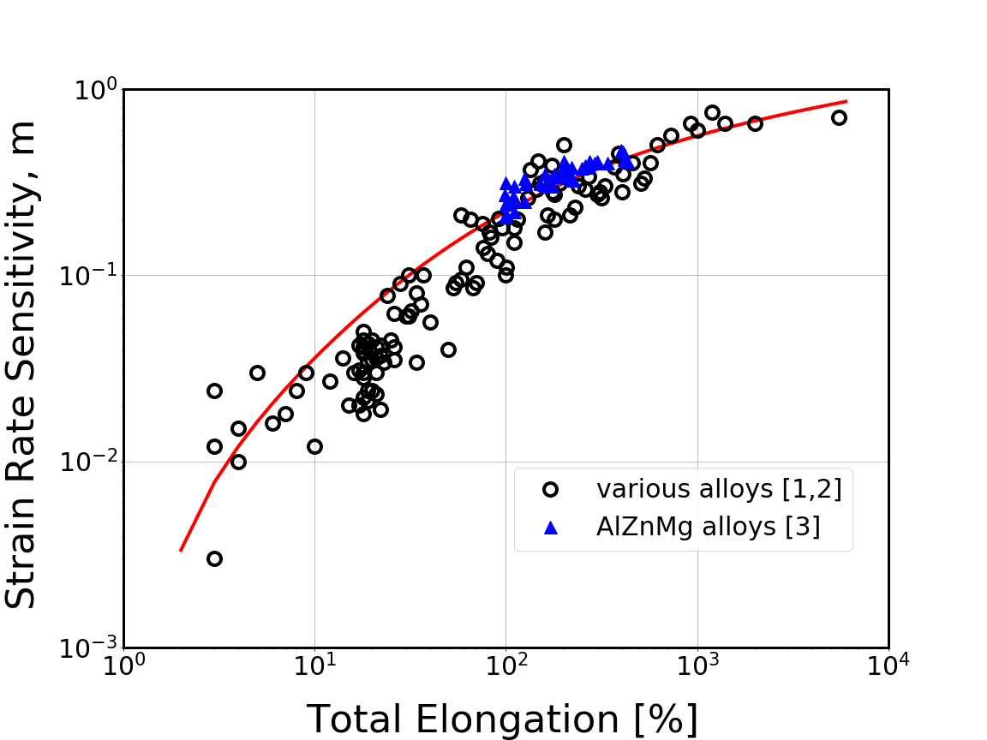
New results: Ultrafine-grained AlZnMg alloys
New results on the ductility of UFG AlZnMgZr samples:
Estimating the ductility of the investigated samples by investigating strain rate sensitivity (SRS)
(NQC et al., MSEA 759 (2019) 448.))
Notes:
Itt azt próbáltuk megnézni, hogy milyen hőmérsékleten javítható, illetve superkélékenyen alakítható az UFG anyag. Figyelembe kell venni azt, hogy deformáció során hőkezelve van az UFG minta. Így azt is meg kell nézni, hogy egyes hőmérsékleten való hőkezelés után még milyen marad az UFG anyag szilárdsága?

Slide 16
New results: Ultrafine-grained AlZnMg alloys
New results on the ductility of the UFG AlZnMgZr samples:
Strain rate sensitivity (SRS) determined by indentation creep
(NQC and SzP, MSEA 611(2014) 333-336. )
Notes:
Ide 2 - 4 ábra kellene

Slide 17
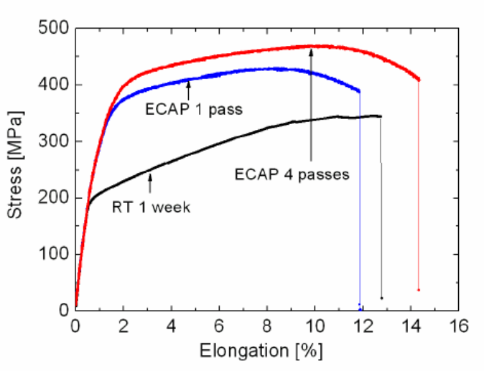
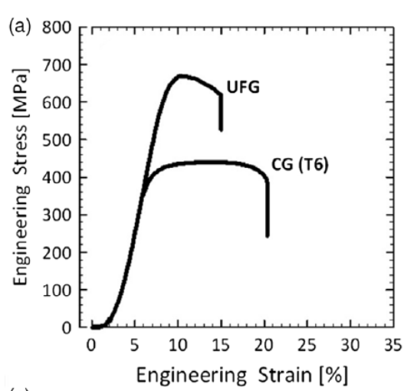
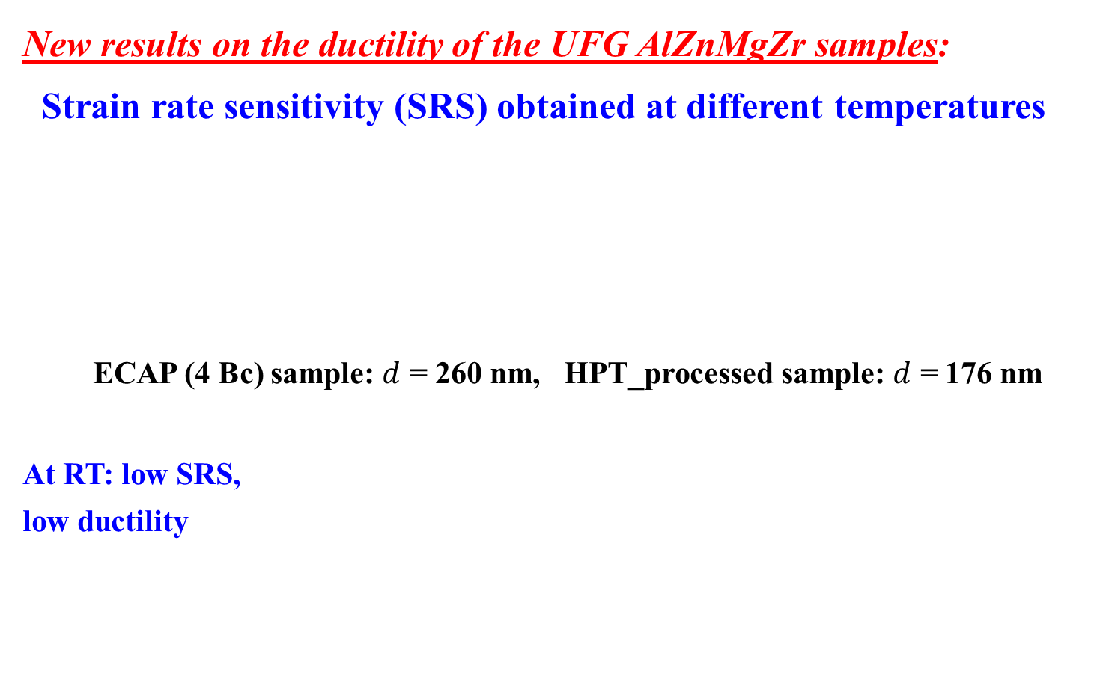
New results: Ultrafine-grained AlZnMg alloys
New results on the ductility of the UFG AlZnMgZr samples:
Strain rate sensitivity (SRS) obtained at different temperatures
ECAP (4 Bc) sample: $d$ = 260 nm, HPT_processed sample: $d$ = 176 nm
At RT: low SRS,
low ductility
 | SRS at RT | at 100 ºC | at 120 ºC | at 140 ºC | at 170 ºC
ECAP (4 Bc) | 0.07 | 0.15 | 0.32 | 0.32 | 0.36
HPT_10 | 0.11 | 0.45 | 0.44 | 0.41 | 0.41

Slide 18
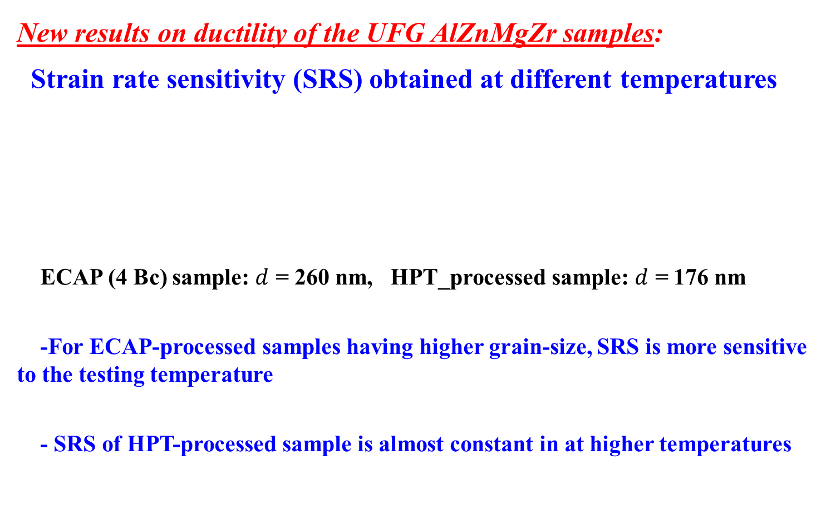
New results: Ultrafine-grained AlZnMg alloys
New results on ductility of the UFG AlZnMgZr samples:
Strain rate sensitivity (SRS) obtained at different temperatures
ECAP (4 Bc) sample: $d$ = 260 nm, HPT_processed sample: $d$ = 176 nm
-For ECAP-processed samples having higher grain-size, SRS is more sensitive to the testing temperature
- SRS of HPT-processed sample is almost constant in at higher temperatures
 | SRS at RT | at 100 ºC | at 120 ºC | at 140 ºC | at 170 ºC
ECAP (4 Bc) | 0.07 | 0.15 | 0.32 | 0.32 | 0.36
HPT_10 | 0.11 | 0.45 | 0.44 | 0.41 | 0.41

Slide 19
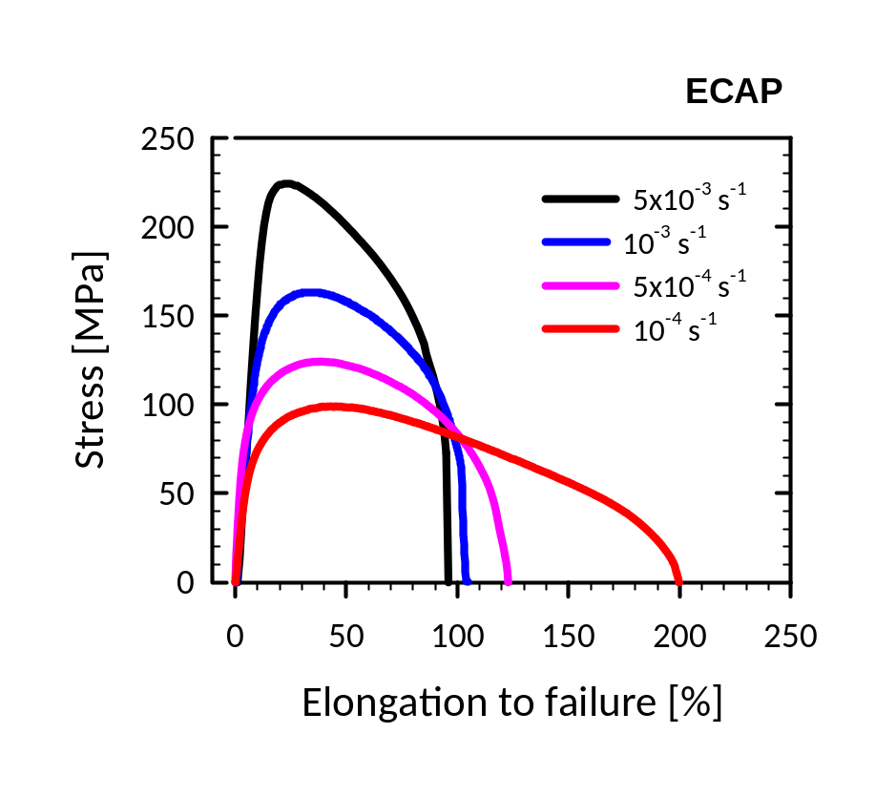
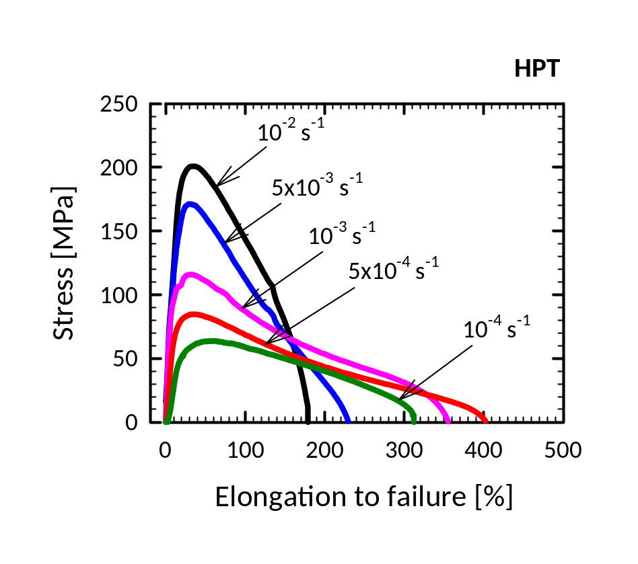
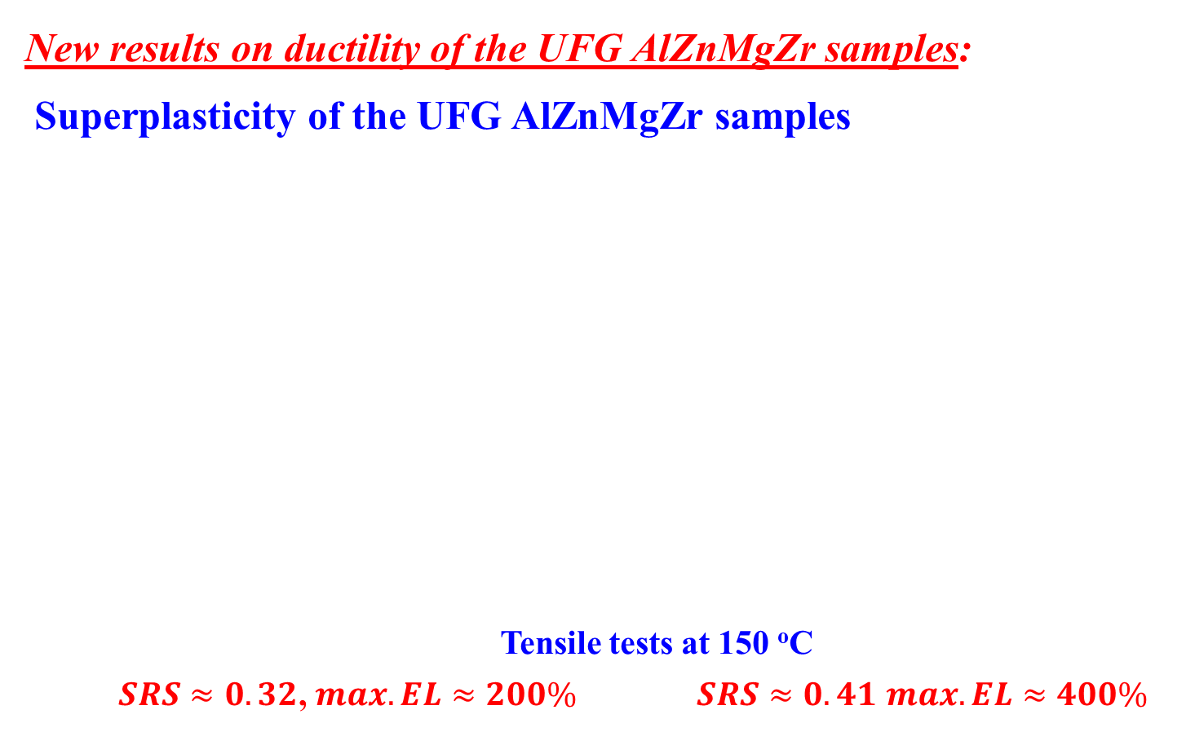
New results: Ultrafine-grained AlZnMg alloys
New results on ductility of the UFG AlZnMgZr samples:
Superplasticity of the UFG AlZnMgZr samples
Tensile tests at 150 ºC
$SRS≈0.32$, $max. EL≈200\%$ $SRS≈0.41$ $max. EL≈400\%$
Notes:
Valami olyasmit, hogy igen sokat javítható a Ductility
A HPT minta jobban ductility, összhangban van a nagyobb m

Slide 20
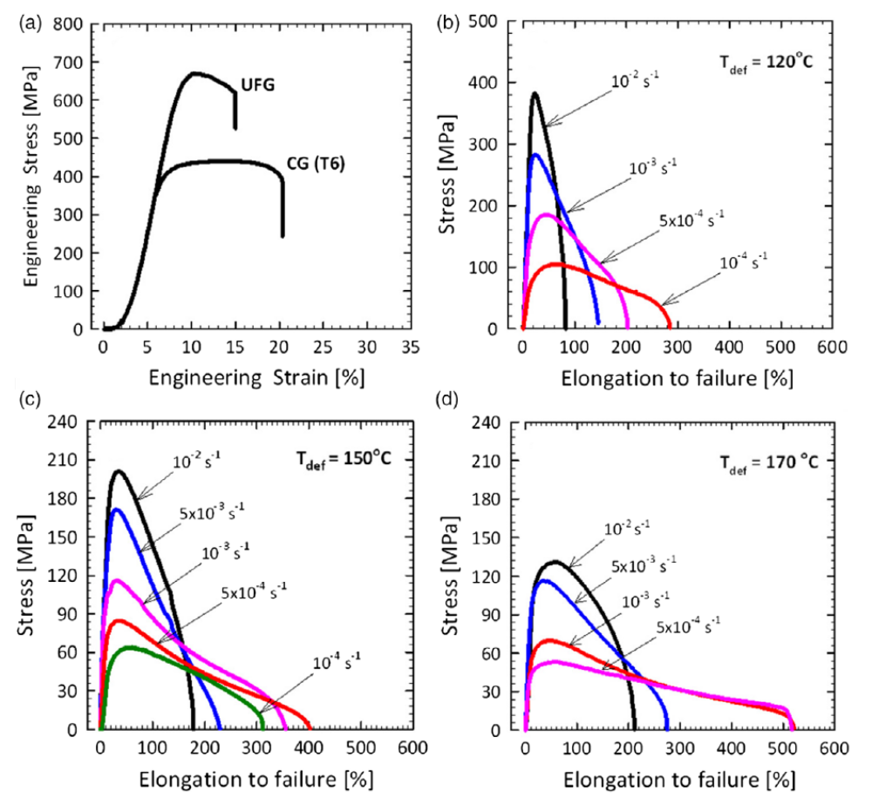
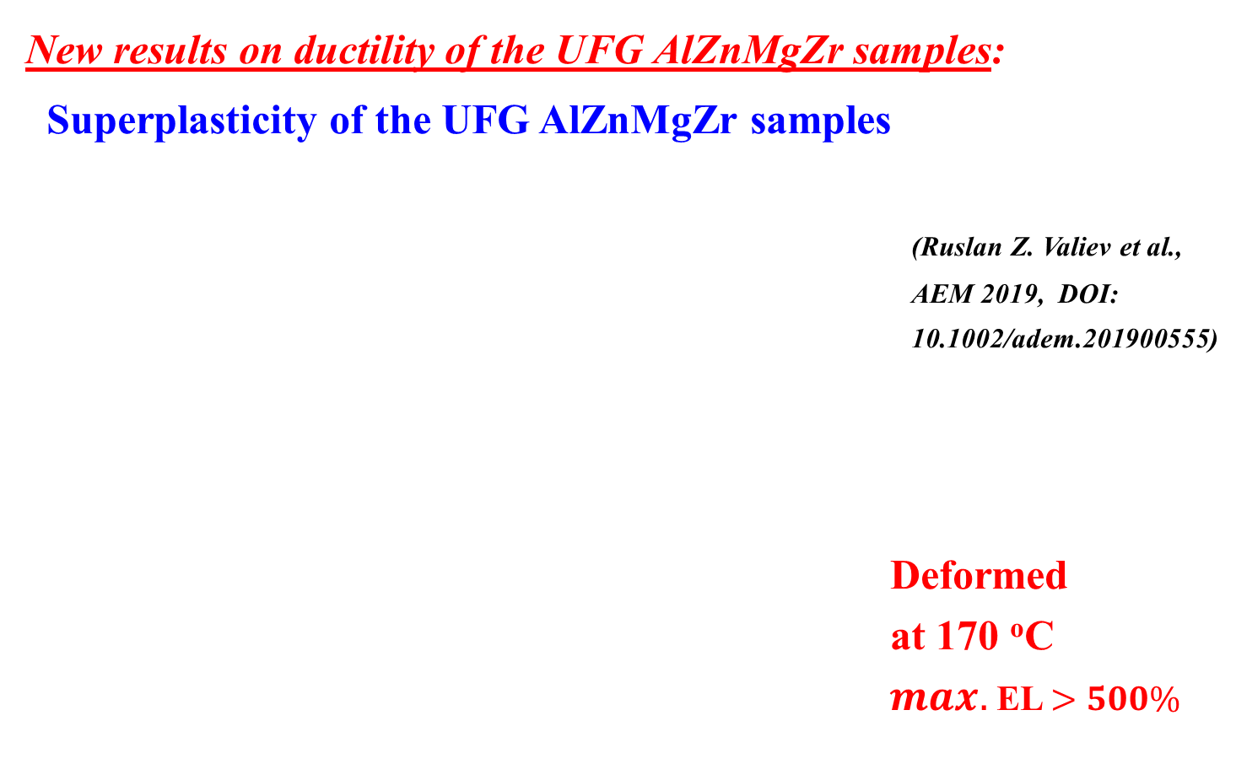
New results: Ultrafine-grained AlZnMg alloys
New results on ductility of the UFG AlZnMgZr samples:
Superplasticity of the UFG AlZnMgZr samples
(Ruslan Z. Valiev et al.,
AEM 2019, DOI:
10.1002/adem.201900555)
Deformed
at 170 ºC
$max.$EL $>500\%$
Notes:
Valami olyasmit, hogy igen sokat javítható a Ductility
A HPT minta jobban ductility, összhangban van a nagyobb m. A 120 C hőmérsékleten deformálva a nagy SRS érték azt suggalja, hogy nagyobb max. elongation should be érhető, de csak 300%. Valószínűleg alacsonyabb sebességen kellene deformálni. De az is lehet, hogy más egyéb dinamikus hatást is kellene megnézni. További vizsgálatok lesznek.

Slide 21



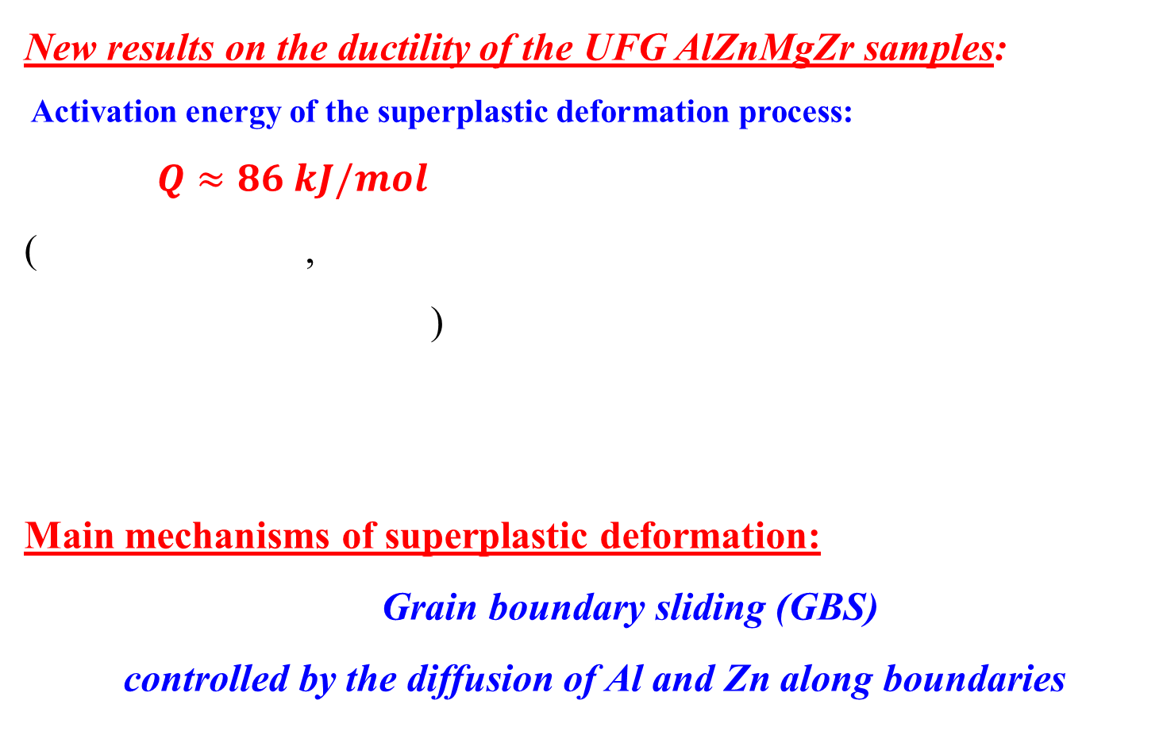
New results: Ultrafine-grained AlZnMg alloys
New results on the ductility of the UFG AlZnMgZr samples:
Activation energy of the superplastic deformation process:
$Q≈86 kJ/mol$
( ,
)
Main mechanisms of superplastic deformation:
Grain boundary sliding (GBS)
controlled by the diffusion of Al and Zn along boundaries
(H.J. Frost, M..F Ashby: Deformation-Mechanism Maps:
The Plasticity and Creep of Metals and Ceramics.
Pergamon Press, Oxford, UK (1982))

Slide 22
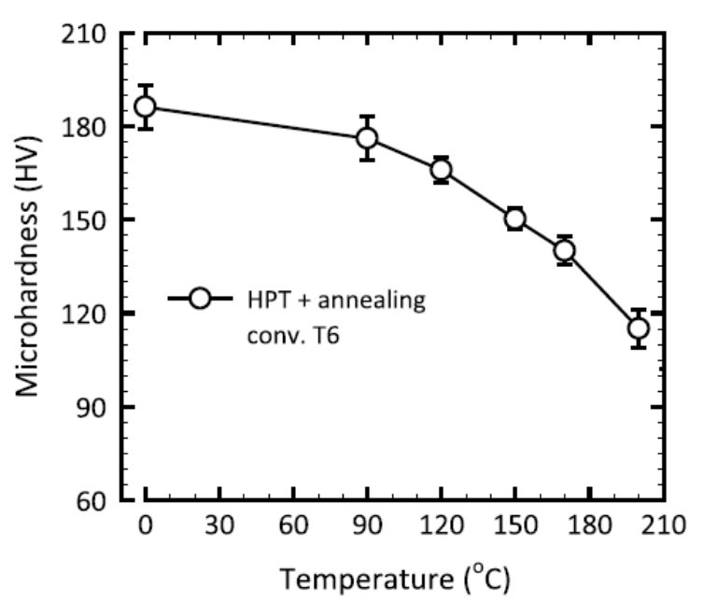
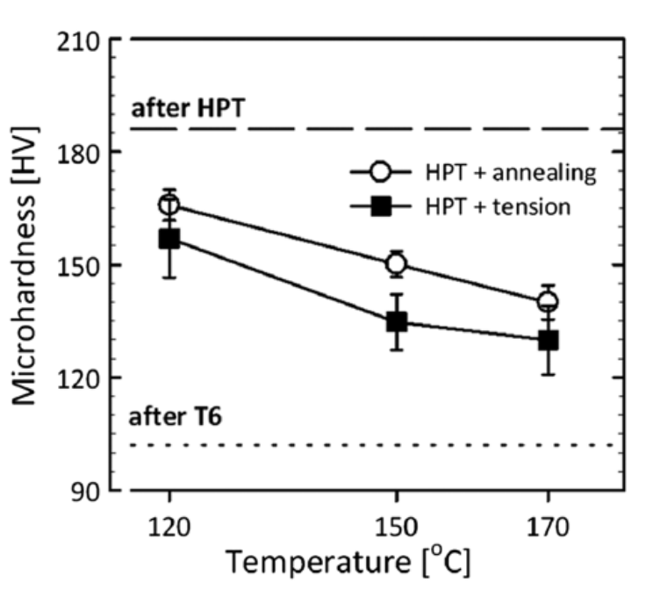
New results: Ultrafine-grained AlZnMg alloys
New results on the ductility of the UFG AlZnMgZr samples:
Effect of the artificial ageing on the strength and microstructure of HPT-processed samples
(Ruslan Z. Valiev et al., AEM 2019, DOI: 10.1002/adem.201900555)
The hardness of the samples after superplastic deformation
remains higher than the value of conventional samples after T6 treatment

Slide 23
New results: Ultrafine-grained AlZnMg alloys
New results on the ductility of the UFG AlZnMgZr samples:
Effect of the artificial ageing on the strength and microstructure of HPT-processed samples
Ageing at 120 and 170 ºC
● A fast decreasing region at the
begening, because of the
fast dissolution of GP zones.
● The hardness obtained after
2 hours remains still higher than
the value characterizing T6.

Slide 24
New results: Ultrafine-grained AlZnMg alloys
New results on the ductility of the UFG AlZnMgZr samples:
Effect of the artificial ageing on the strength and microstructure of ECAP-processed samples
Ageing at 120 and 170 ºC
● A fast decreasing region at the
begening, because of the
fast dissolution of GP zones.
● The hardness obtained after
only few minutes decreases below
the value characterizing T6.

Slide 25
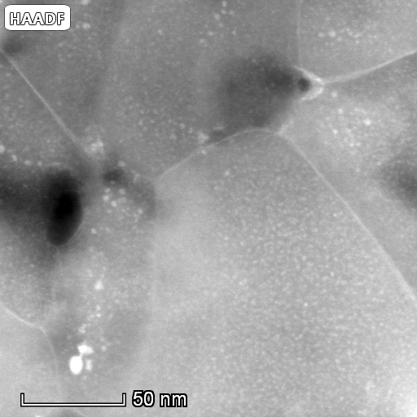
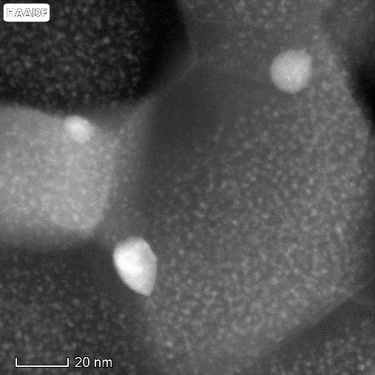
New results: Ultrafine-grained AlZnMg alloys
New results on the ductility of the UFG AlZnMgZr samples:
Effect of the artificial ageing on the microstructure
HPT_10 ECAP (4Bc)

Slide 26
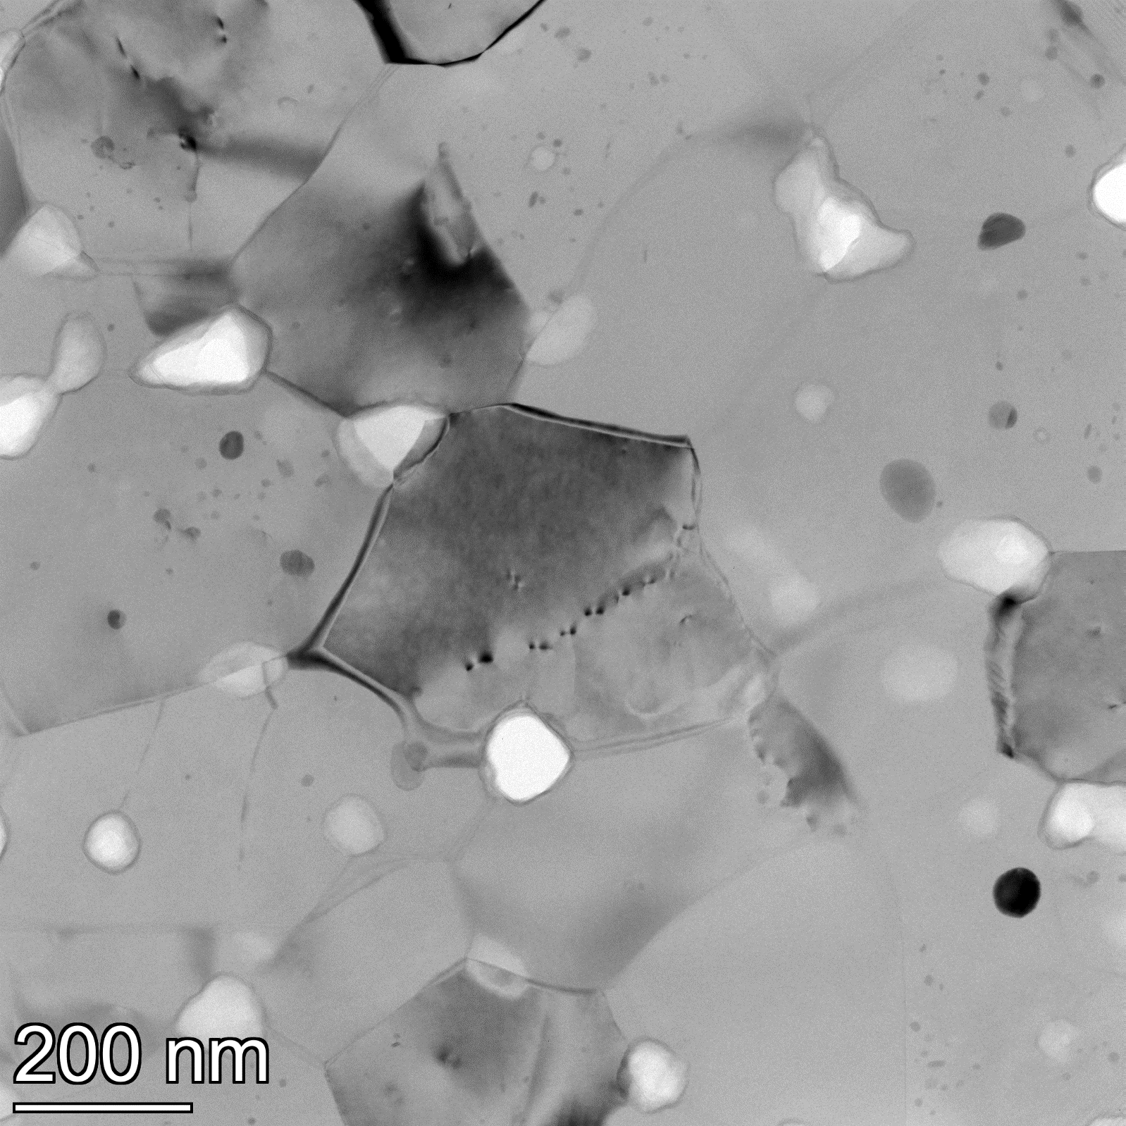
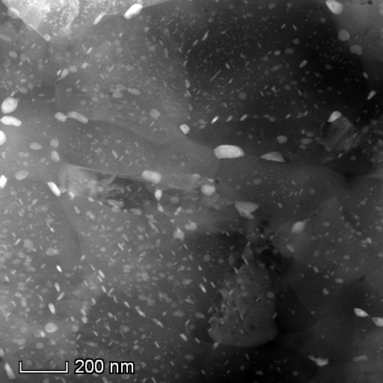
New results: Ultrafine-grained AlZnMg alloys
New results on the ductility of the UFG AlZnMgZr samples:
Effect of the artificial ageing on the microstructure
HPT_10_RT + 170ºC (2h) ECAP (4Bc) + 170ºC (2h)

Slide 27
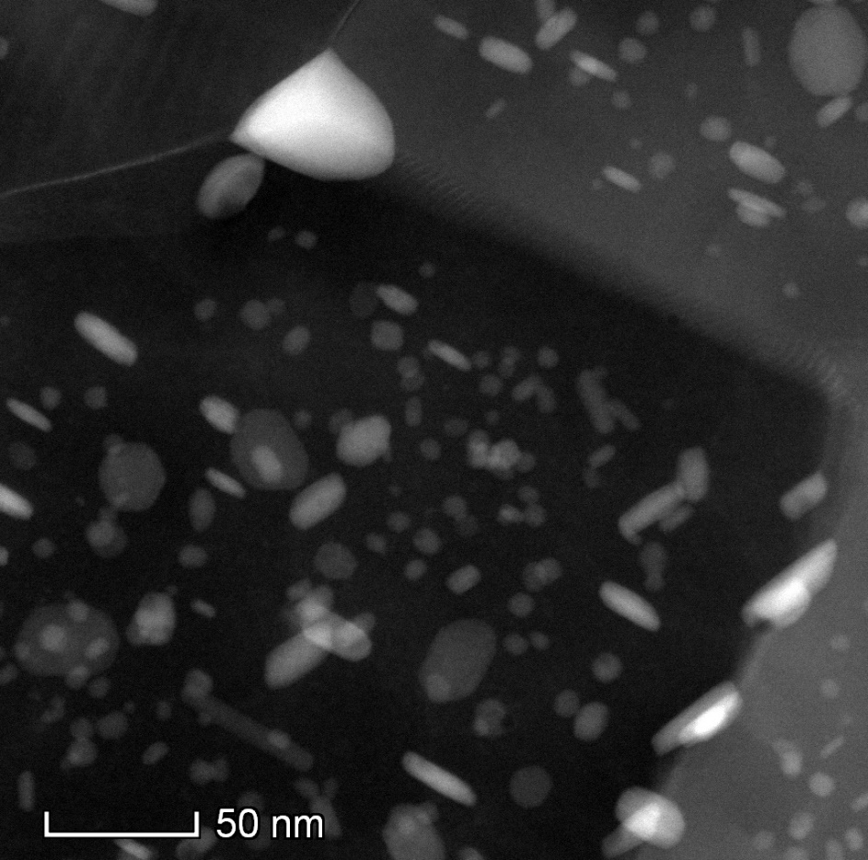
New results: Ultrafine-grained AlZnMg alloys
New results on the ductility of the UFG AlZnMgZr samples:
Effect of the artificial ageing on the microstructure
HPT_10_RT + 170ºC (2h) ECAP (4Bc) + 170ºC (2h)
ECAP minta

Slide 28
New results: Ultrafine-grained AlZnMg alloys
Possible deformation mechanisms of superplastic deformation at low temperature in UFG AlZnMgZr
Significant difference between the SRS and ductility of the HPT- and ECAP-processed samples deformed at 120 or 170ºC.
Significant difference between the microstructure of the HPT- and ECAP-processed samples after the same aging at 120 or 170ºC for 2 h.
The high dislocation density in HPT sample may facilitates the migration of Zn atoms to the grain boundaries. The diffusion of Zn along boundaries then enhanced the role of the GBS mechanism.

Slide 29
New results: Ultrafine-grained AlZnMg alloys
Possible deformation mechanisms of superplastic deformation at low temperature in UFG AlZnMgZr
Significant difference between the SRS and ductility of the HPT- and ECAP-processed samples deformed at 120 or 170ºC.
Significant difference between the microstructure of the HPT- and ECAP-processed samples after the same aging at 120 or 170ºC for 2 h.
Main mechanisms of superplastic deformation:
Grain boundary sliding (GBS)
controlled by the diffusion of Al and Zn along boundaries

Slide 30
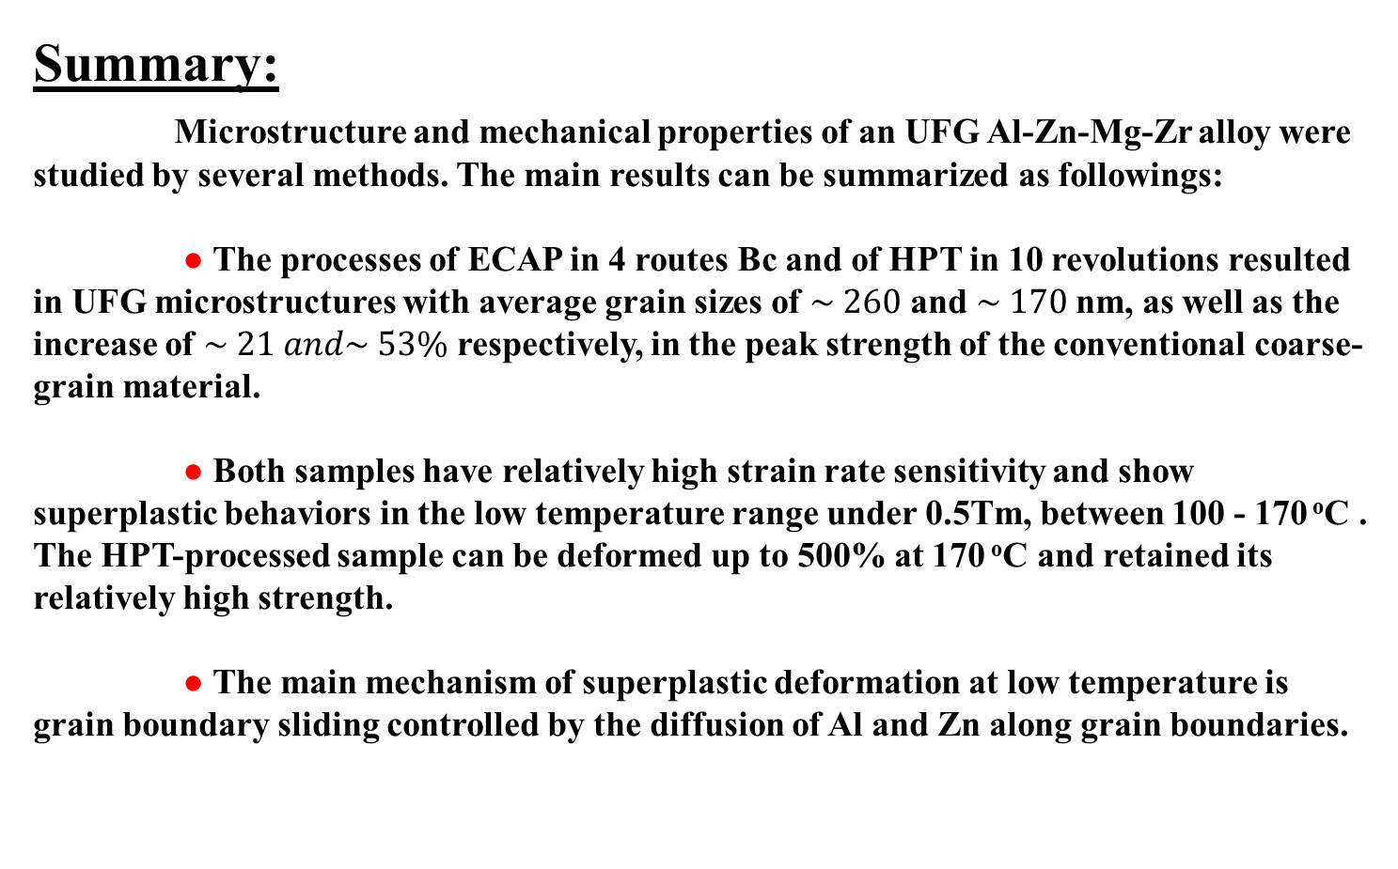
New results: Ultrafine-grained AlZnMg alloys
Summary:
Microstructure and mechanical properties of an UFG Al-Zn-Mg-Zr alloy were studied by several methods. The main results can be summarized as followings:
● The processes of ECAP in 4 routes Bc and of HPT in 10 revolutions resulted in UFG microstructures with average grain sizes of $\sim 260$ and $\sim 170$nm, as well as the increase of $\sim 21 and\sim 53\%$ respectively, in the peak strength of the conventional coarse-grain material.
● Both samples have relatively high strain rate sensitivity and show superplastic behaviors in the low temperature range under 0.5Tm, between 100 - 170 ºC . The HPT-processed sample can be deformed up to 500% at 170 ºC and retained its relatively high strength.
● The main mechanism of superplastic deformation at low temperature is grain boundary sliding controlled by the diffusion of Al and Zn along grain boundaries.

Slide 31
New results: Ultrafine-grained AlZnMg alloys
Acknowledgements:
● The present research was financed by the Hungarian-Russian bilateral Research program (TÉT) No. 2017-2.3.4-TÉT-RU-2017-00005 (Hungarian group) and by the Ministry of Education and Science of the Russian Federation under grant agreement No. 14.586.21.0061 (unique project identifier RFMEFI58618X0061) (Russian group)
● This work was supported also by the Ministry of Human Capacities of Hungary within the ELTE University Excellence program (1783-3/2018/FEKUTSRAT)

Slide 32
New results: Ultrafine-grained AlZnMg alloys
Thank you for your attention

